Slide 1
Prove each of the following statements, or give a counterexample
a. Breadth-first search is a special case of uniform-cost search.
When all step costs are equal (and let’s assume equal to 1), g(n) is just a multiple of depth n. Thus, breadth-first search and uniform-cost search would behave the same in this case f(n) = g(n) = 1*(depth of n)
g(n): a path cost to n from a start state

Slide 2
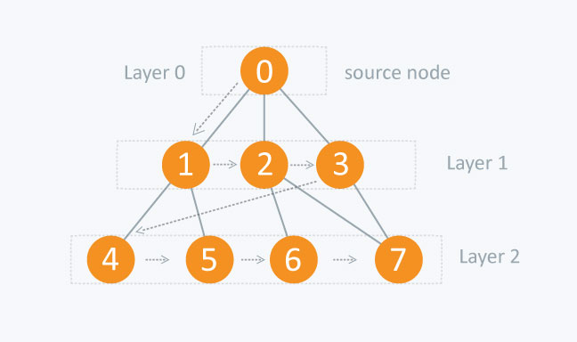
Breadth First Search (BFS)

Slide 3
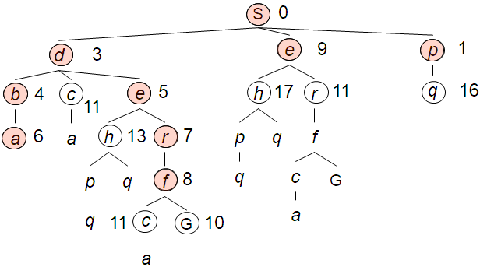
Uniform Cost Search (USC)

Slide 4
b. Depth-first search is a special case of best-first tree search.
Breadth-first search is best-first search with f(n) = depth(n); depth-first is best-first search with f(n) = −depth(n).

Slide 5
c. Uniform-cost search is a special case of A∗ search.
A* search: f(n) = g(n) + h(n) Uniform-cost search: f(n) = g(n) Thus, for h(n) = 0, uniform cost search will produce the same result as A* search
h(n): a heuristic estimate of cost from n to a goal state
g(n): a path cost to n from a start state

Slide 6
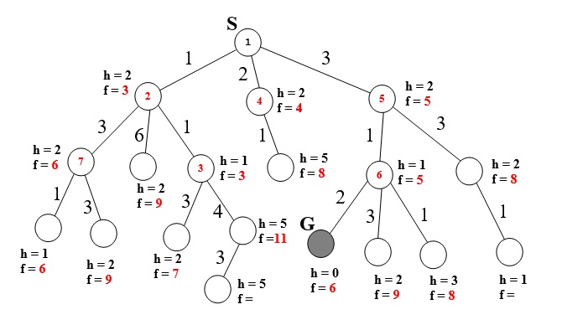

Slide 7
Evaluation function: f(n) = (2 − w)g(n) + wh(n)
Completeness
w = 0: f(n)=2g(n) --> Uniform Cost Search, which is complete.
w = 1: f(n)=g(n) + h(n) --> A*, which is complete.
w = 2: f(n)=2h(n) --> greedy Best First Search, which is not complete.
Cost > 0 so f(n) > 0.
f(n) = (2 − w)g(n) + wh(n)
0 ≤ w < 2

Slide 8
Evaluation function: f(n) = (2 − w)g(n) + wh(n)
Optimality
The algorithm is guaranteed to be optimal for 0 ≤ w ≤ 1, since scaling g(n) by a constant has no effect on the relative ordering of the chosen paths, but, if w > 1 then it is possible the wh(n) will overestimate the distance to the goal, making the heuristic inadmissible. If w ≤ 1, then it will reduce the estimate, but it is still guaranteed to underestimate the distance to the goal state.

Slide 9
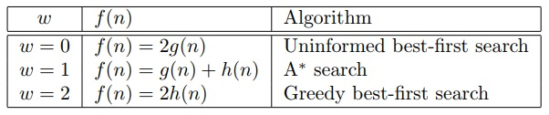
Evaluation function: f(n) = (2 − w)g(n) + wh(n)
Search behavior with w = 0, 1, 2

